Slide 1
Tutorial on how to train BERT with GPU on Kaggle
Nguyen Xuan Binh
Nguyen Long

Slide 2
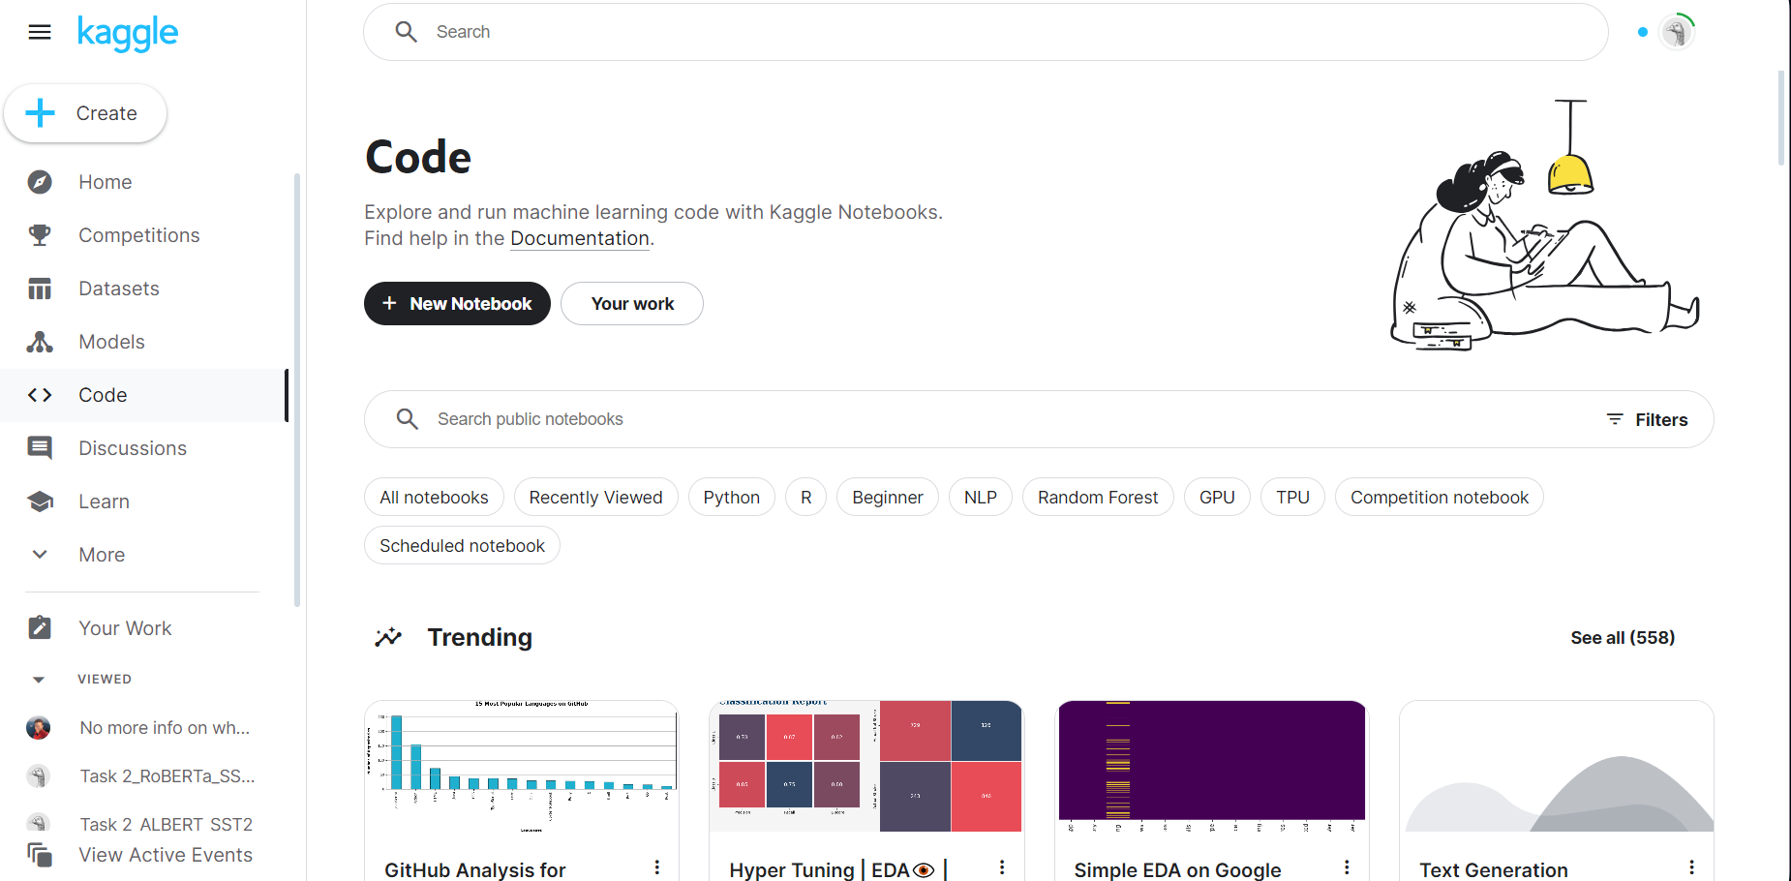
Step 1: Logging into your Kaggle account. The main page should look something like this

Slide 3
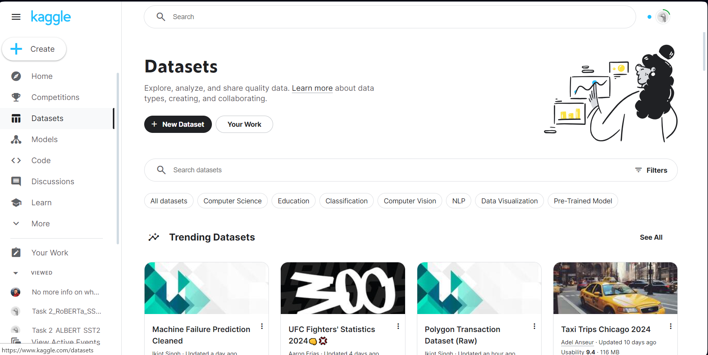
Step 2: Click on Dataset => Choosing “Your Work”

Slide 4
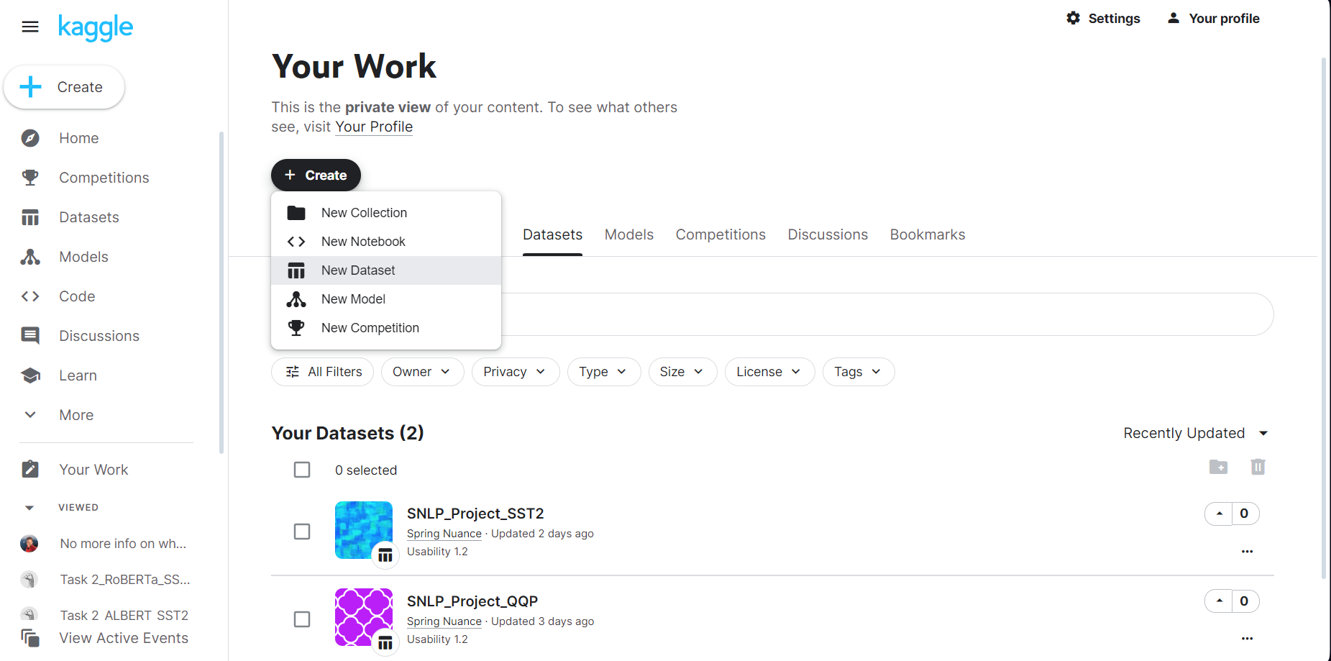
Step 3: Create New Dataset and upload QQP and SST2 dataset

Slide 5
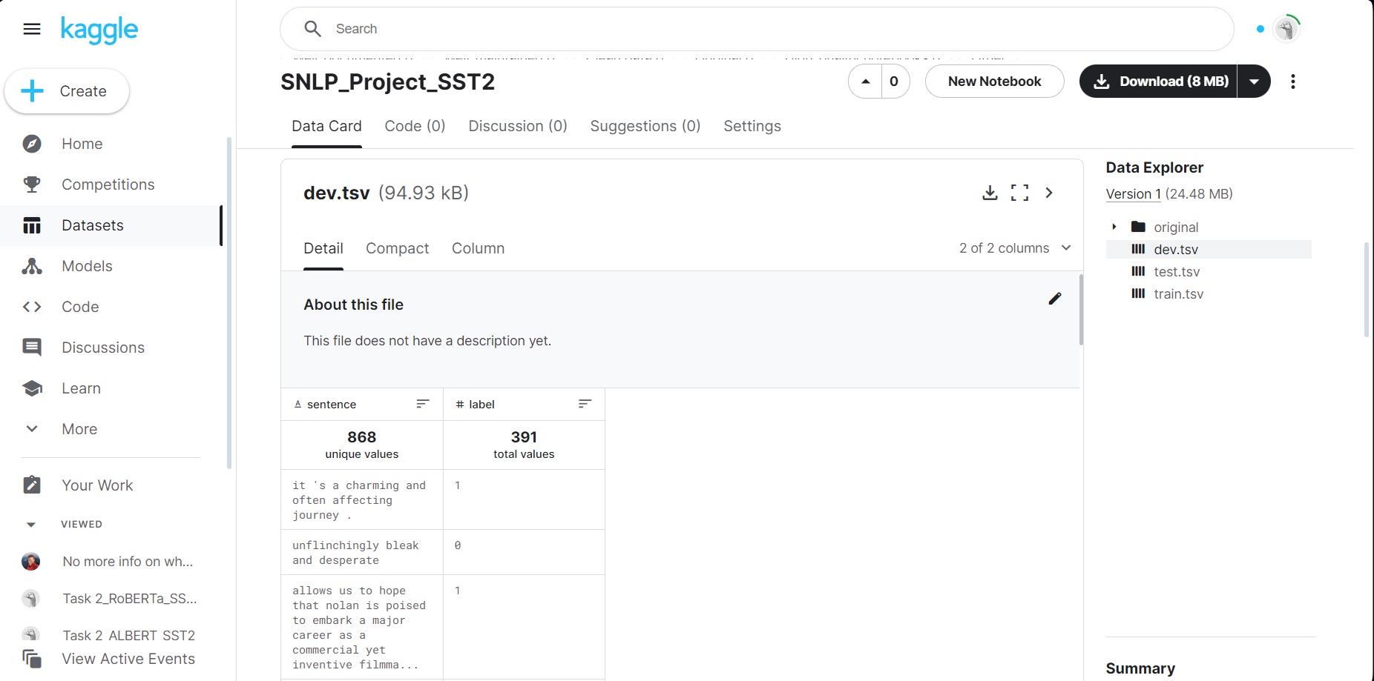
SST2 dataset contains dev.tsv, test.tsv and train.tsv

Slide 6
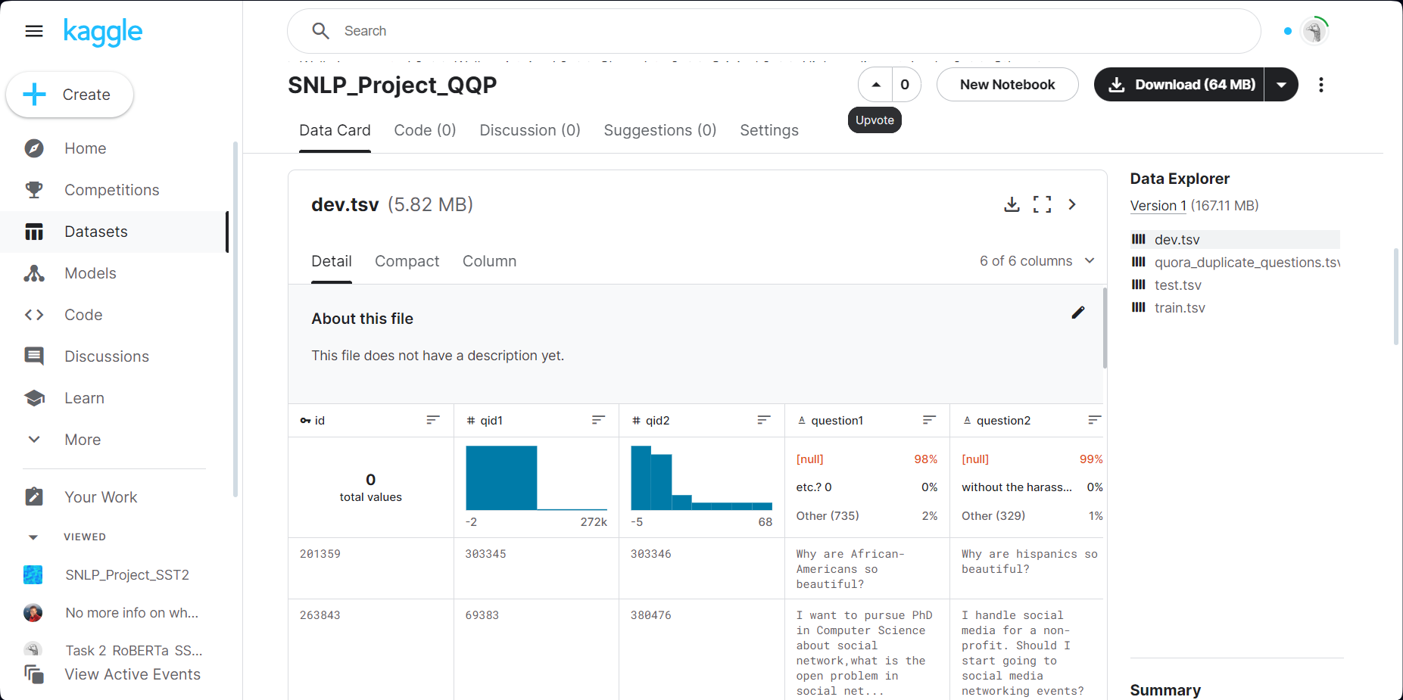
QQP dataset contains dev.tsv, test.tsv and train.tsv

Slide 7

Step 4: Click on Code tab => “Your work”

Slide 8
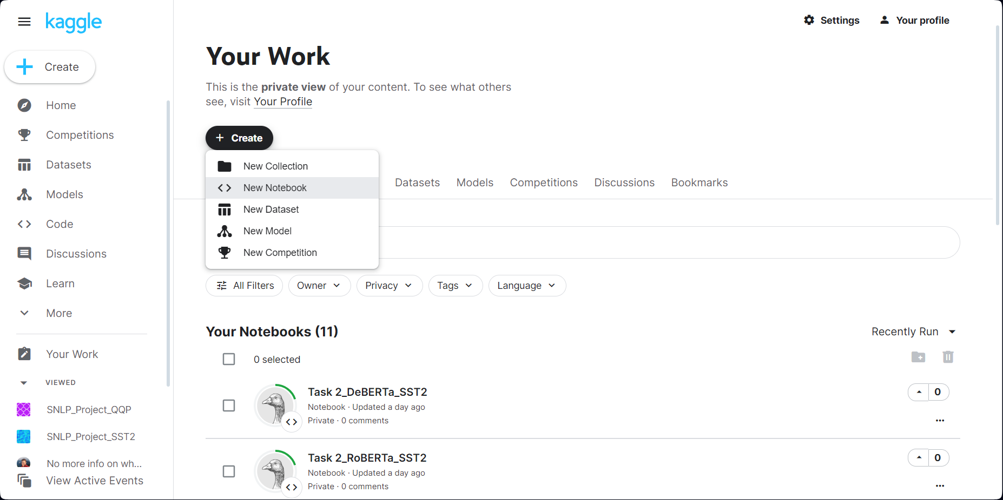
Step 5: Click on Create => “New notebook”

Slide 9
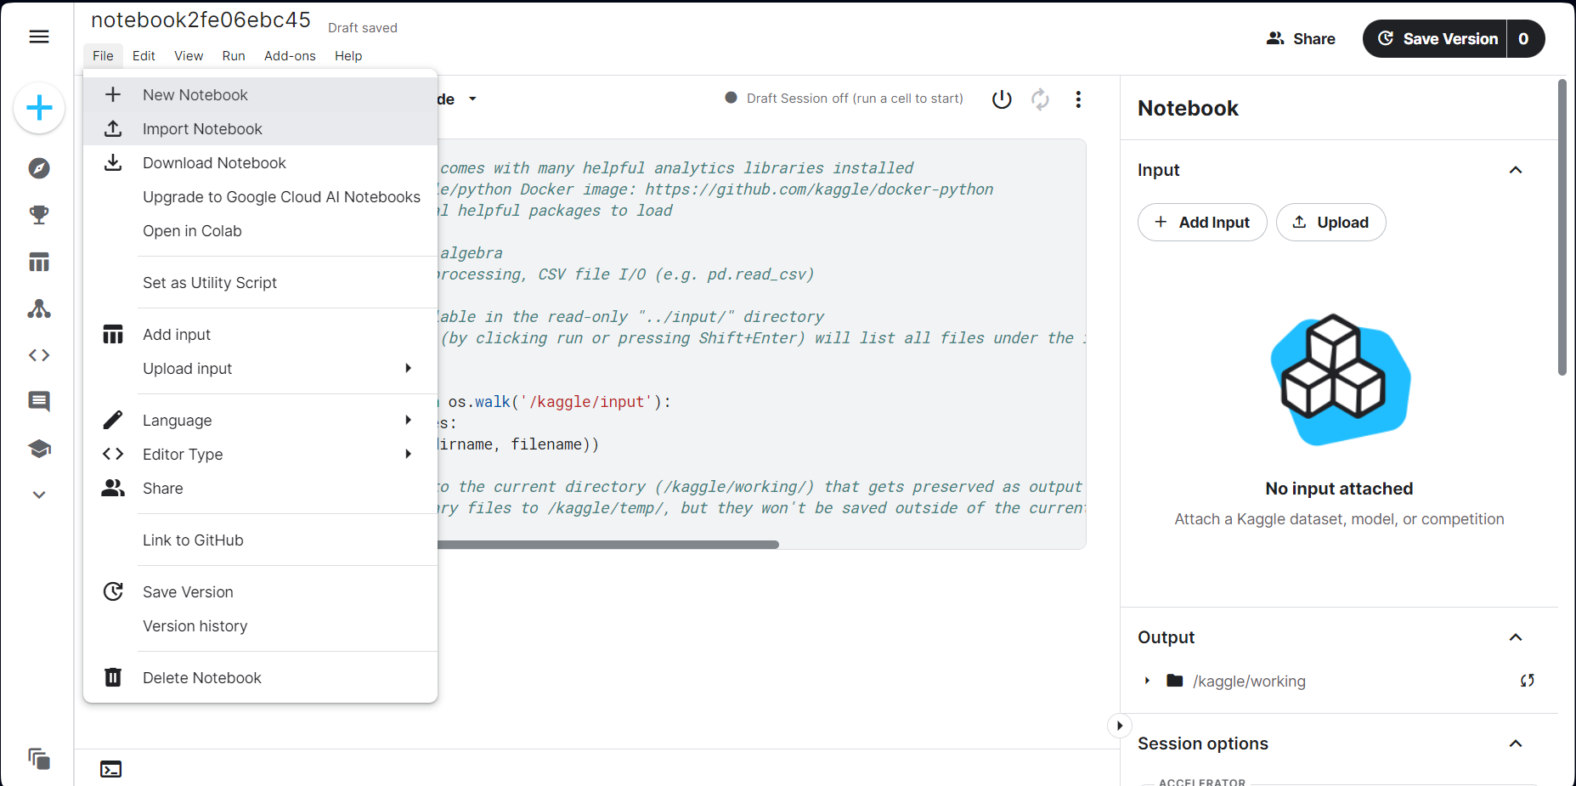
Step 6: Click on Import Notebook => Choose our ipynb developed notebook

Slide 10
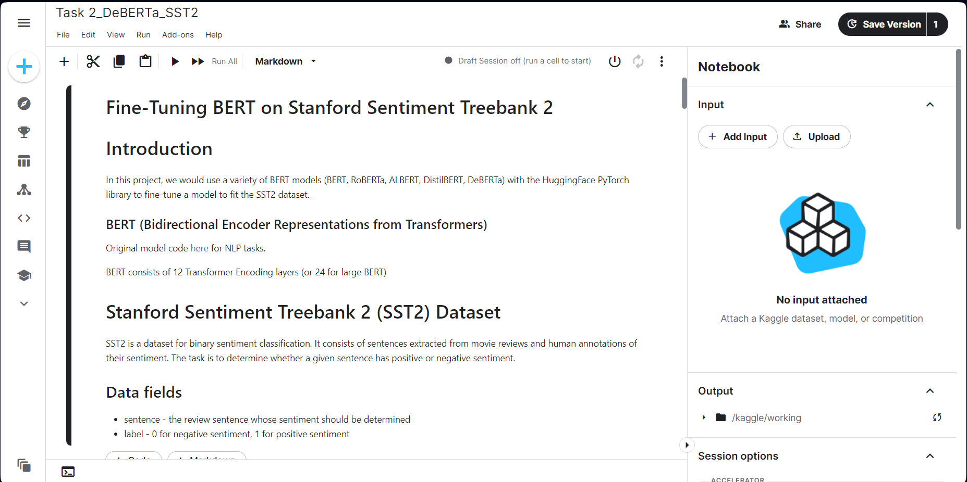
Step 6: Now your notebook should look like this. Then click on “Add input”

Slide 11
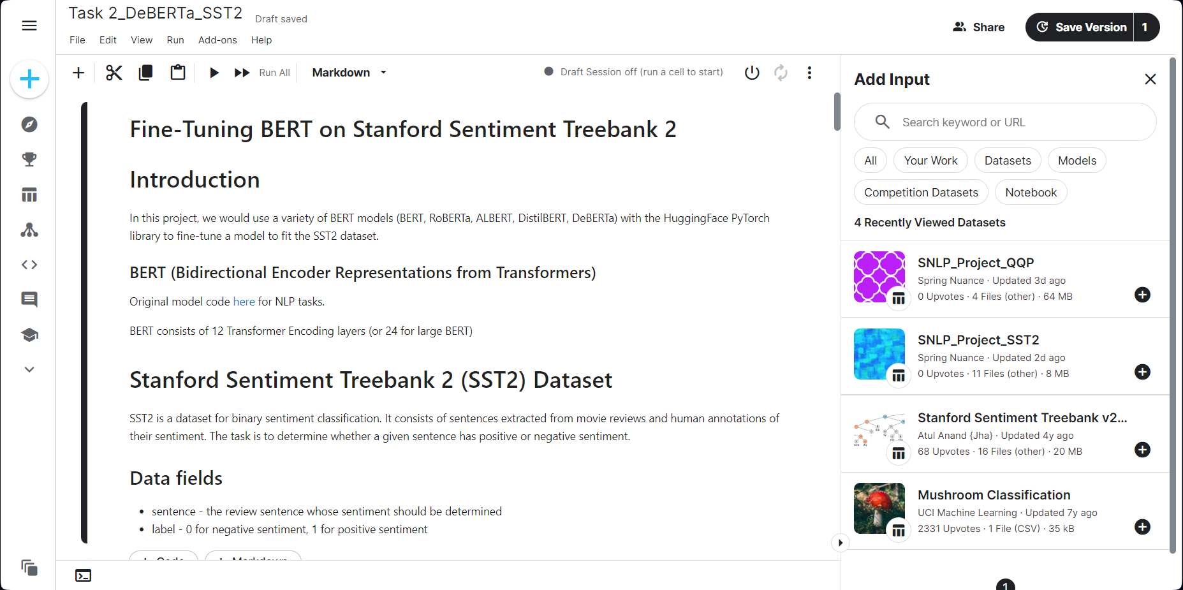
Step 7: Click on “Your work” and choose either QQP or SST2 dataset, depending on the task

Slide 12
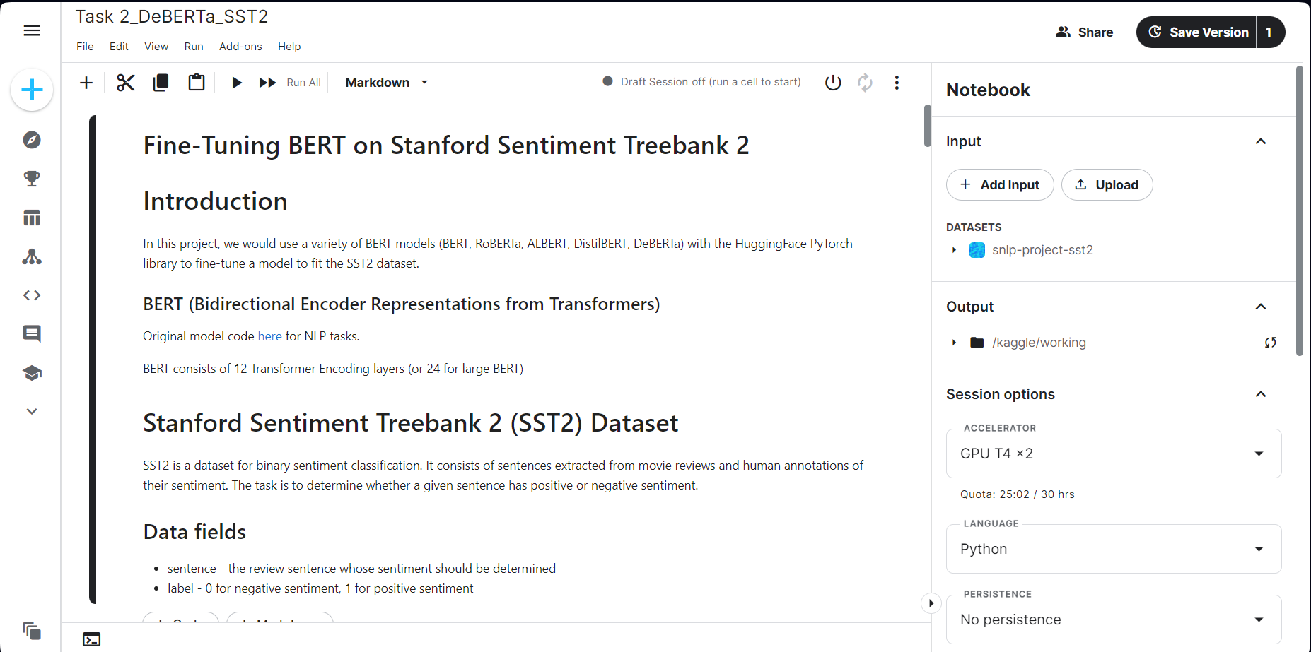
Step 7: Now the dataset has been loaded into your Input tab

Slide 13
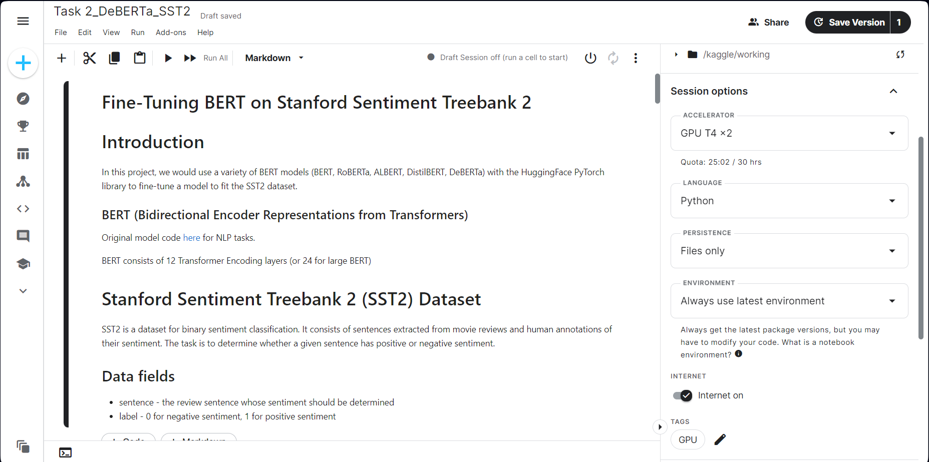
Step 8: In Session options, choose Accelerator: GPU T4 x 2, Language: Python

Slide 14
Step 8: In Session options, choose Persistence: Files only, and Environment: Always use latest environment

Slide 15
Step 8: Toggle on the Internet On. If you don’t do this, BERT cannot download the pretrained model

Slide 16
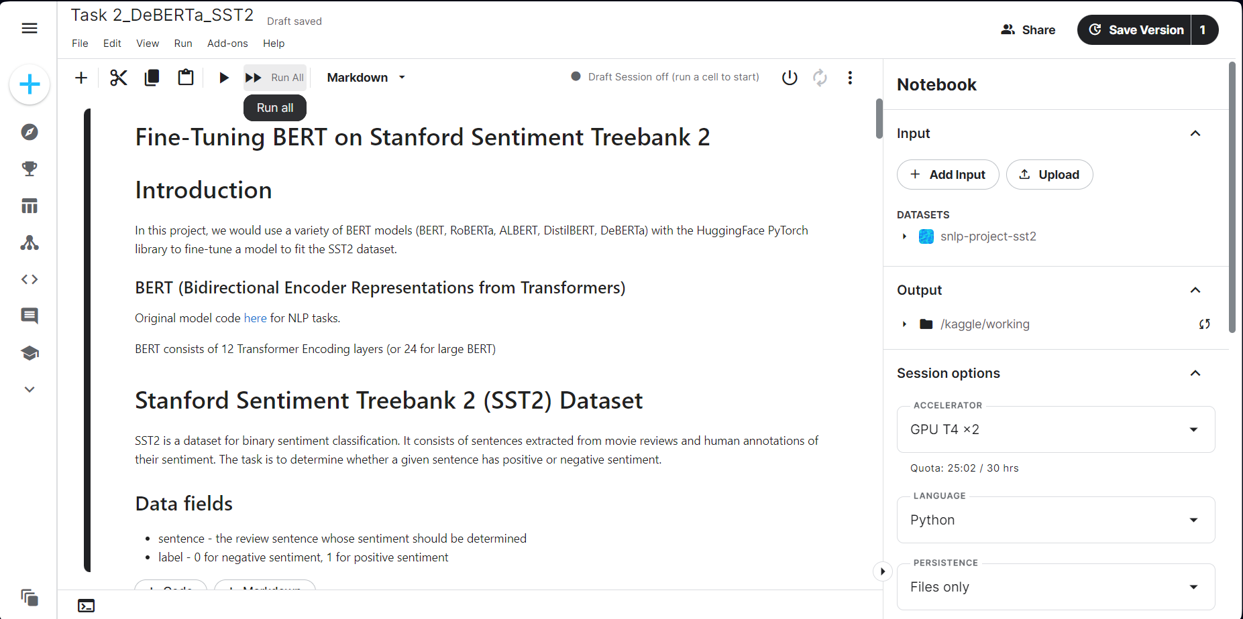
Step 9: Click Run All to train the BERT model from start to finish. The results would appear in kaggle/working

Slide 17
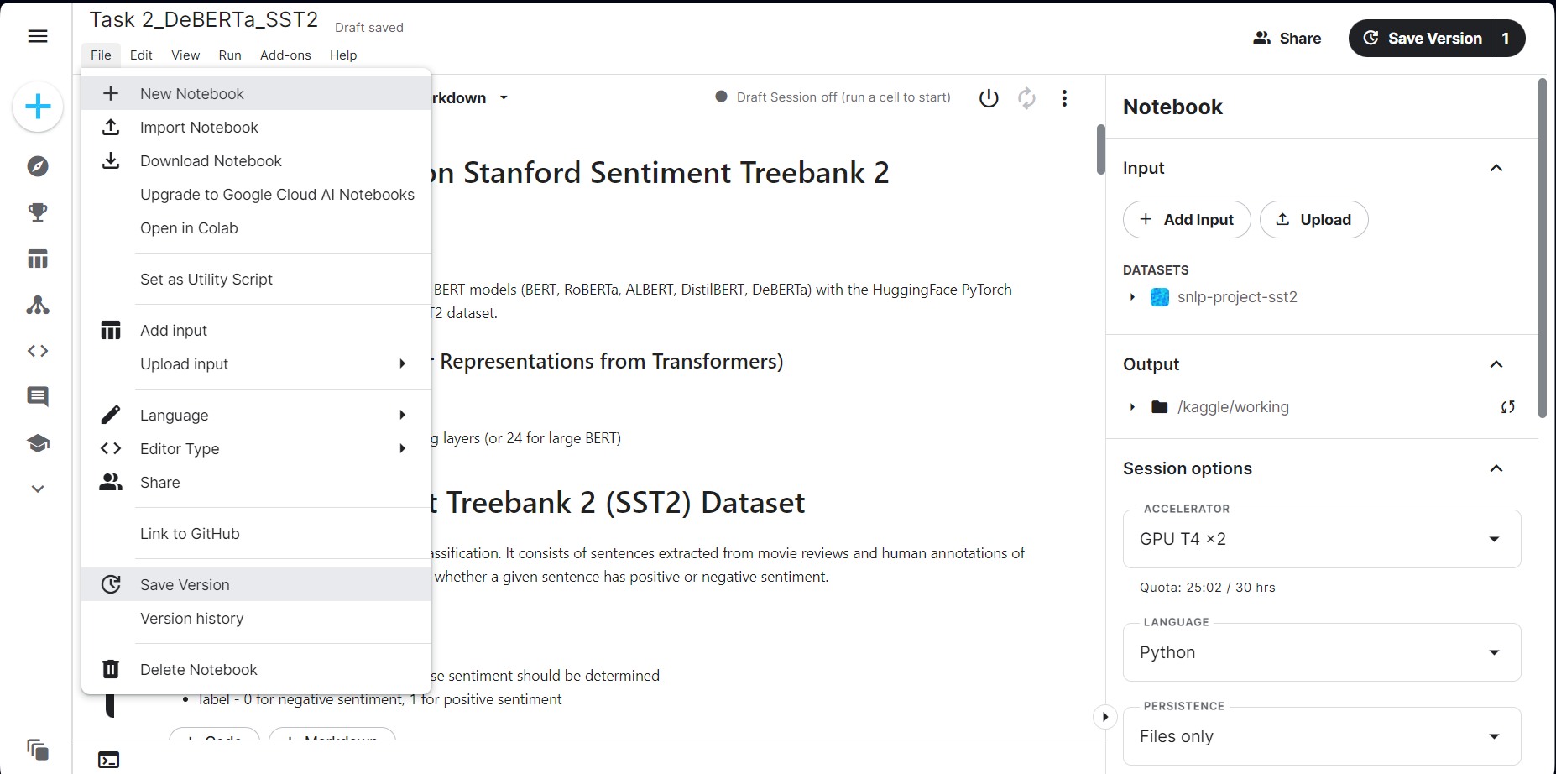
Step 10: When we train models, it is likely that we want to let it run overnight and we cannot keep the computer opened forever. To do this, we can choose File > Save Version.

Slide 18
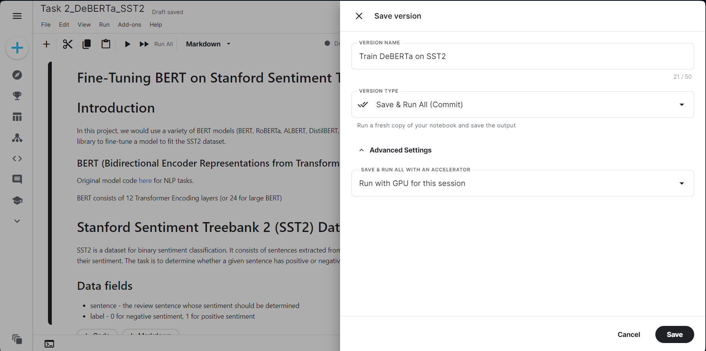
Step 10: Name the version, choose version type as Save & Run all, and choose Run with GPU for this session
The notebook would be submitted to the Kaggle server and runs even when we close the browser.

Slide 19
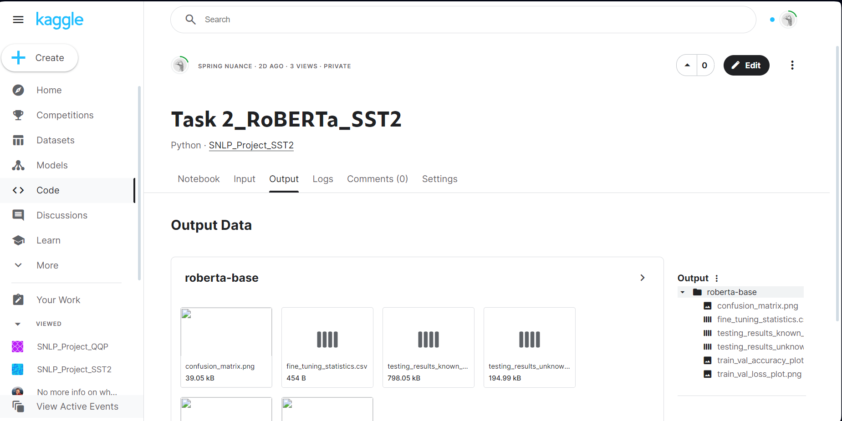
Step 11: Click on View Active Events. You can find your running GPU session

Slide 20
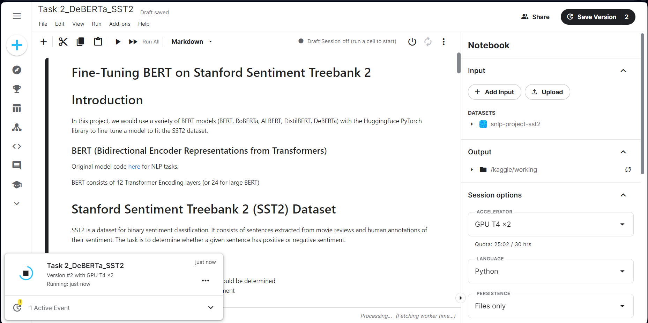
Step 11: Click on View Active Events. You can find your running GPU session

Slide 21
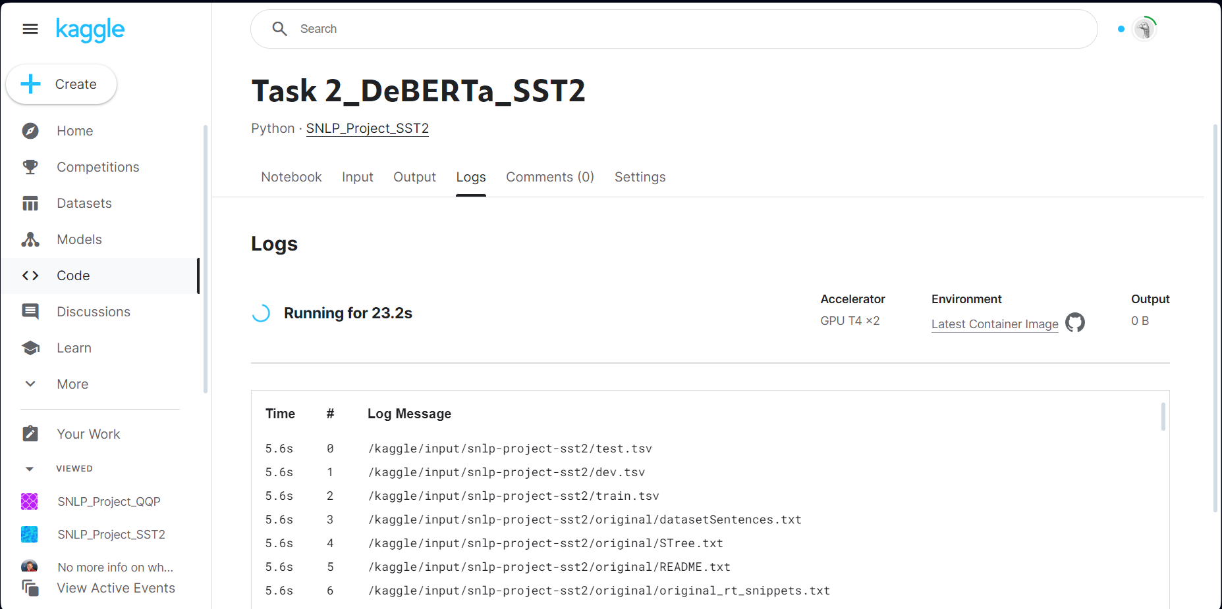
Step 12: Click on the running job, you can look at the Logs to see the running process.

Slide 22
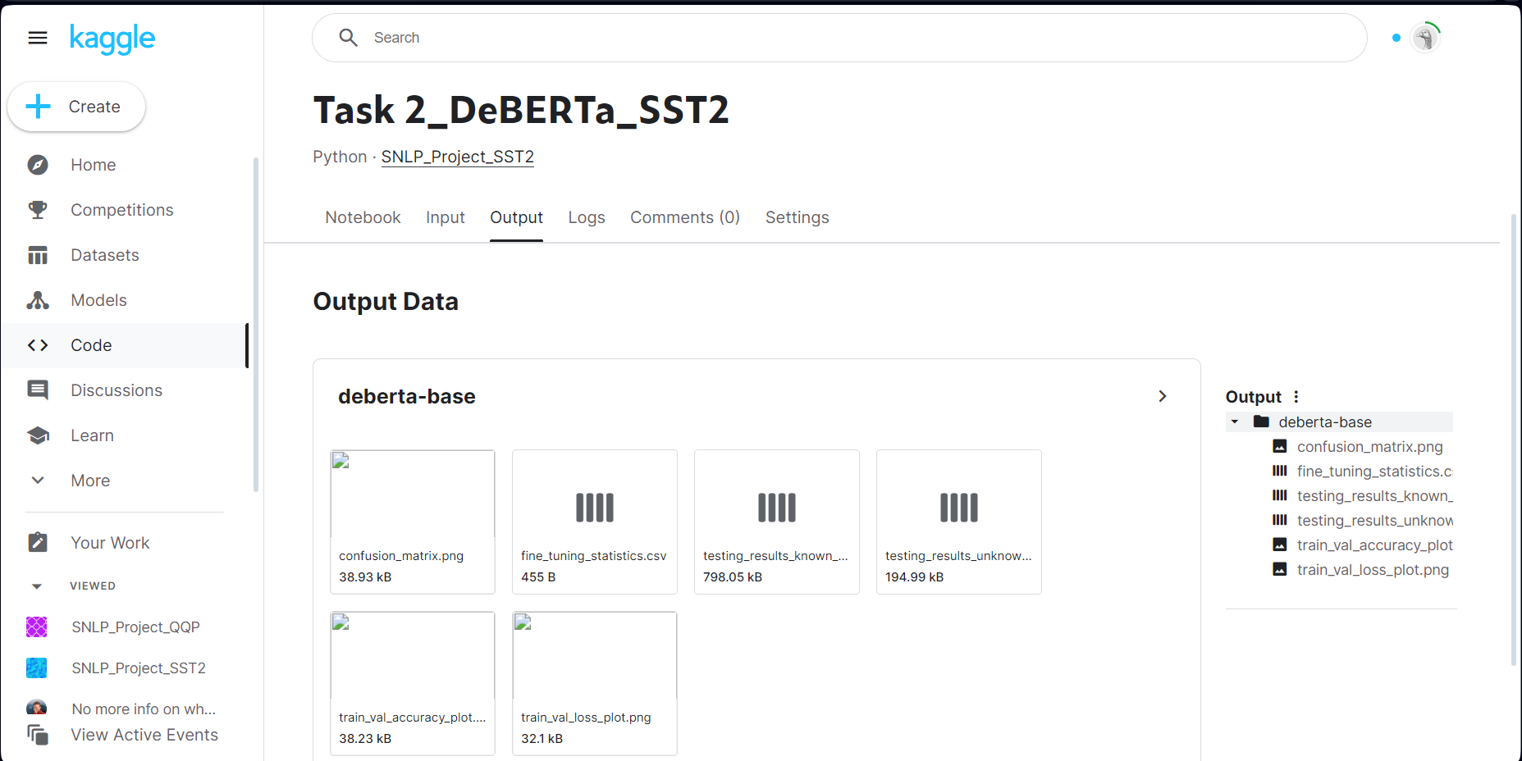
Step 13: After training the model successfully, it would return output files in Output tab.

Slide 23
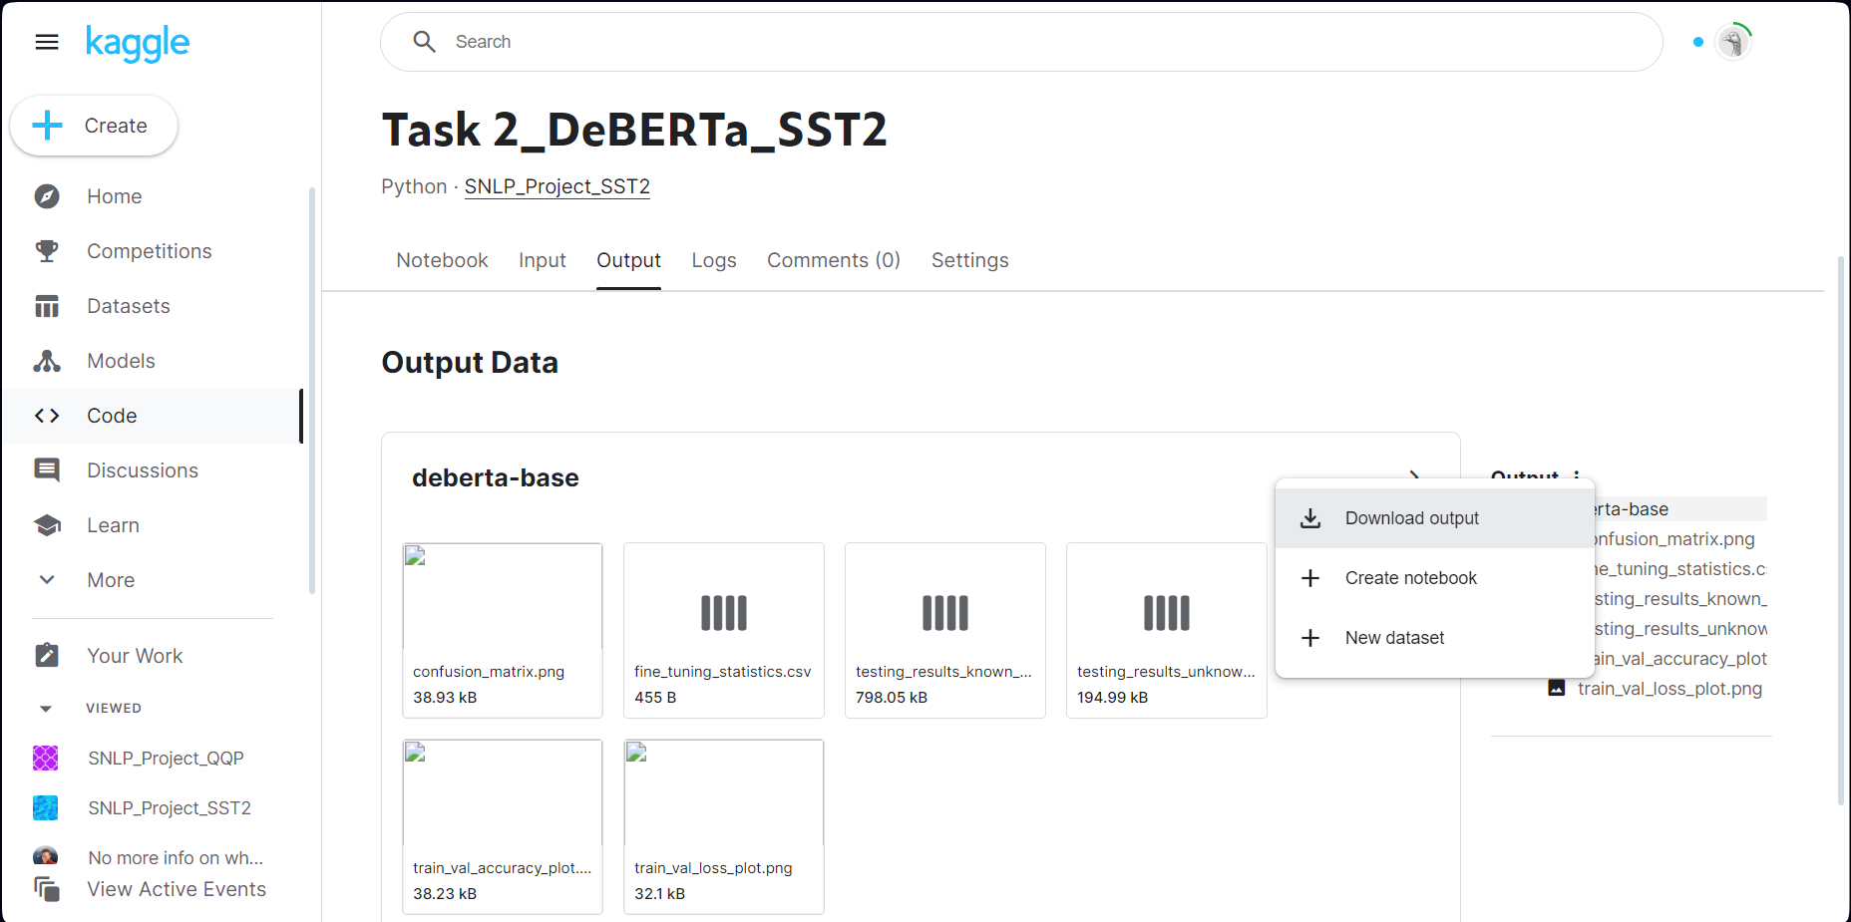
Step 13: Finally, you can download your outputs to your local computer

Slide 24
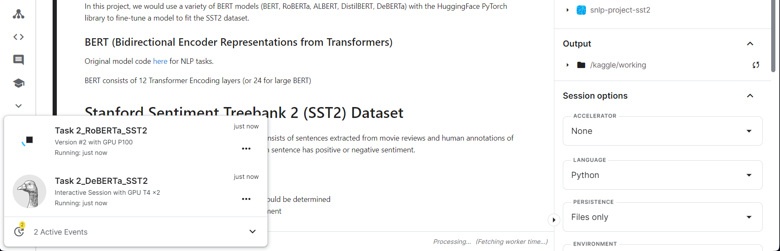
Step 14: Note that there is a limit on the number of GPU active sessions and interactive session
Saved versions using GPU: at most 2 GPU sessions
Interactive session using GPU: at most 1 GPU session
Saved versions is just the tutorial step we follow above. Interactive session is we run the notebook directly on the browser and it would be interrupted if we close the browser.

Slide 25
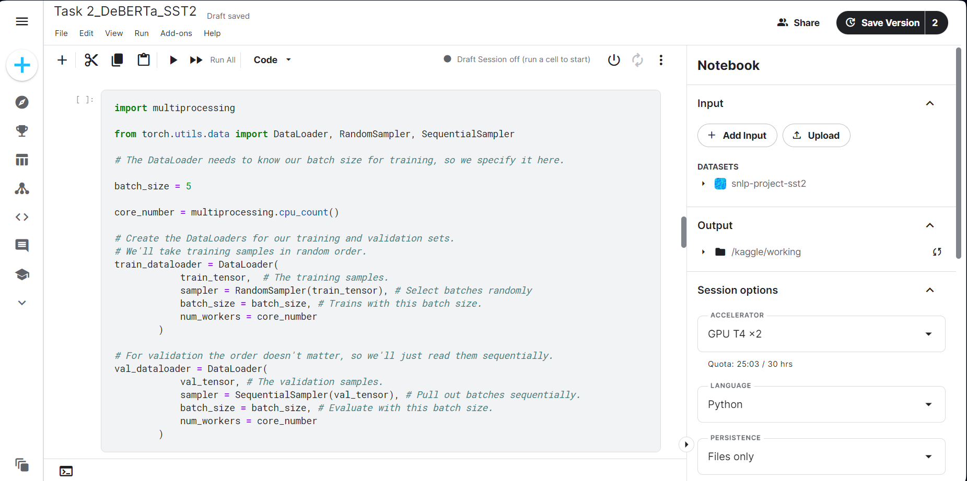
Finally, you should use GPU T4. Using other GPU type would result in running out of memory for GPU, no matter how small the batch size. GPU T4 is the only version that can support batch size of 5-10 sentences.

Slide 26
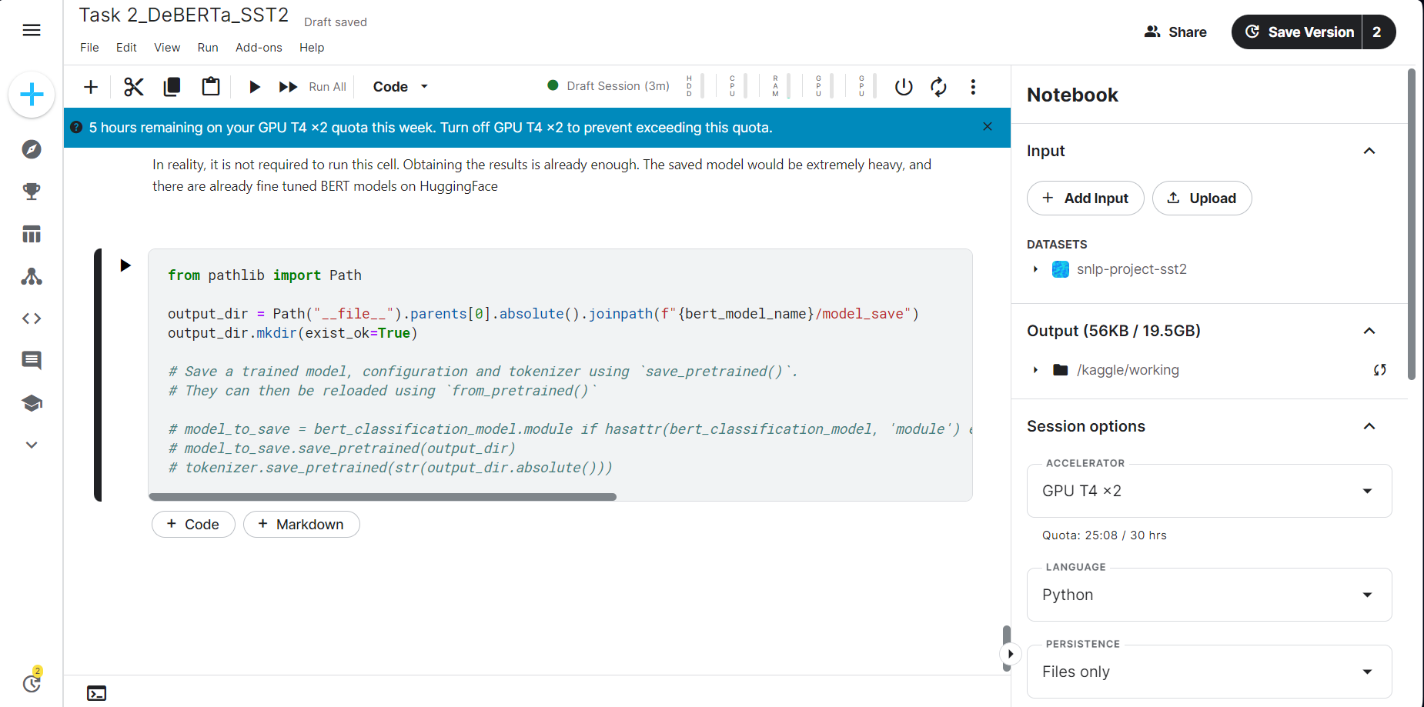
Training on GPU has a quota of 30 hours every week, and it is reset at every Saturday.
You cannot run GPU when you run out of quota, and you must until next Saturday for it to reset

